Slide 1

All it takes is one data point to throw off the prediction
Remove or Ignore data that does not conform to your model or beliefs
Source: Can one rotten apple really spoil the whole bunch? | SiOWfa14 Science in Our World: Certainty and Cont (psu.edu)

Slide 2

What is the Length of Medication Therapy? One-inflated Survival Model
Ka Lok Lee
Srihari Jaganathan

Slide 3
Agenda
Agenda

Slide 4
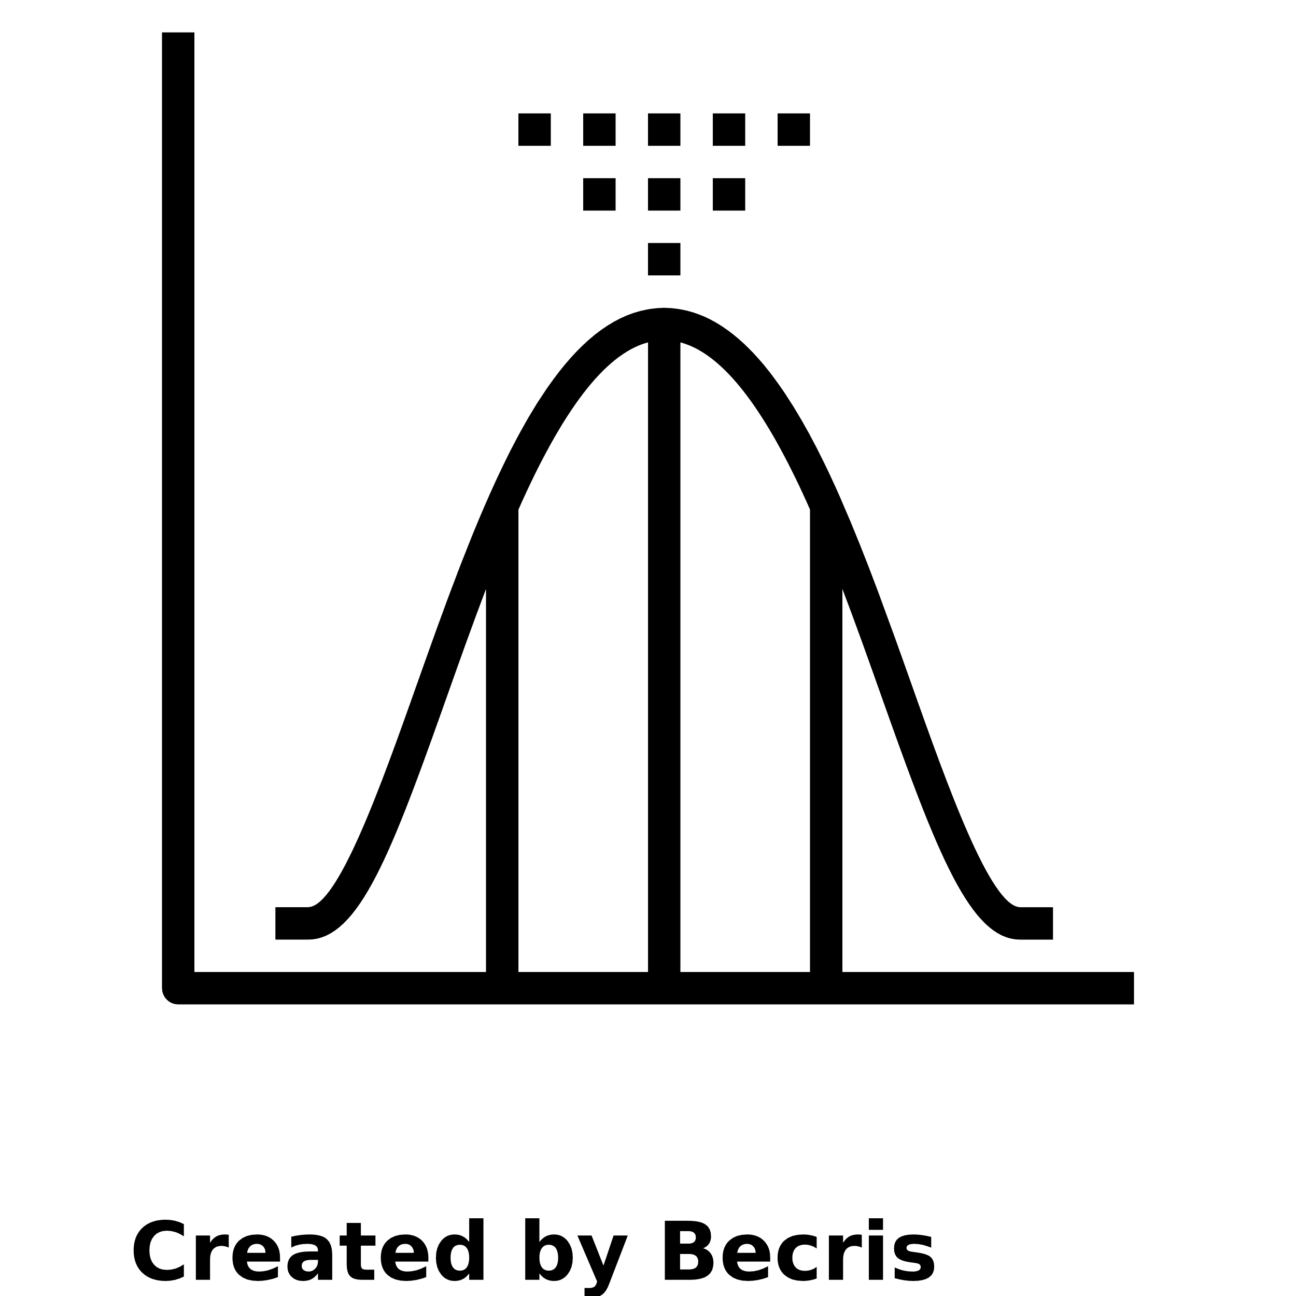


Context: Length of therapy is an important metric in healthcare
Average
Contribution
Remaining Life
How long do patients stay on therapy?
What is the average (expected value) number of months that patient stays on therapy?
HEOR: the overall cost of medication therapy
Commercial: patient lifetime value contribution to the brand
For a patient already stayed for t* months, how many more months will the patient remain on therapy?
Forecast by Kamin Ginkaew from NounProject.com
Average by Becris from NounProject.com
Stopwatch by kiddo from NounProject.com

Slide 5
What is the average length of therapy?
Fitting probability distribution helps to estimate the mean and other properties
% Persistent
A probability distribution, with all the statistical properties, that can capture the underlying data generating process (DGP)
% Drop significant at Month 1
K-M: ~45% of patients are still persistent with the medication at month 9
But this does not answer the question
What we want
Kaplan Meier (Actual Data)
Months (28 Days)

Slide 6
Agenda
Agenda

Slide 7
Answering the question
Our arsenal of standard probability distributions does not fit the data well
% Persistent
We need to get more creative!
Kaplan Meier
Unable to capture Month 1 drop
Lognormal
Exponential
Months (28 Days)

Slide 8
Some issues corelated with steep 1st month drop
Doctors trying to find the effective medication
Patients reporting side effects
Doctors and patients treating the disease acutely and not chronically
Somewhat unique to pharmaceuticals

Slide 9
Agenda
Agenda

Slide 10
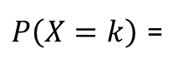
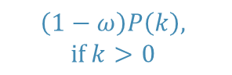
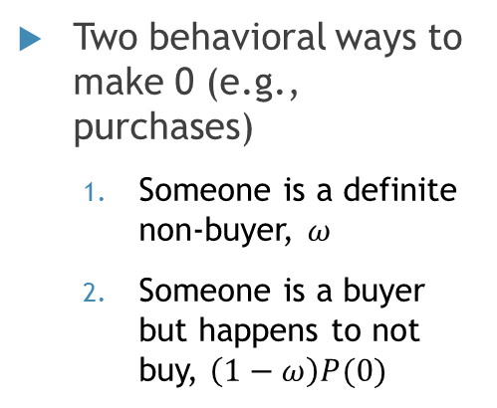
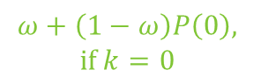
Need a new probability distribution?
The steep drop at month 1 is akin to zero-inflation in count model
For any general count model
1
$$ω+\left(1−ω\right)P\left(0\right)\text{,}$$
$$\text{if} k=0$$
2
$$\left(1−ω\right)P\left(k\right)\text{,}$$
$$\text{if} k>0$$
$P\left(X=k\right)$ =
Two behavioral ways to make 0 (e.g., purchases)
Someone is a definite non-buyer, $ω$
Someone is a buyer but happens to not buy, $\left(1−ω\right)P(0)$
0
1
2
3
4
5+
K

Slide 11

Zero Inflated
Poisson
Inspired
One Inflated Survival

Slide 12

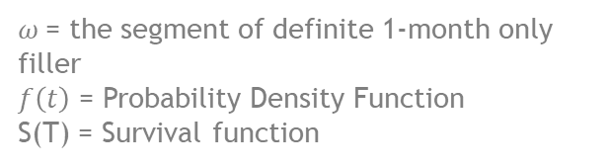


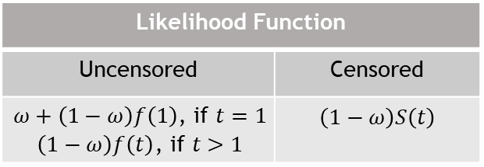
Create a 1-month “inflated” survival model
Uncensored Patients (t=1)
Uncensored Patients (t>1)
Censored Patients
1
$$ω+\left(1−ω\right)f\left(1\right)$$
2
$$\left(1−ω\right)f\left(t\right)$$
3
$$\left(1−ω\right)S(T)$$
$ω$= the segment of definite 1-month only filler
$f\left(t\right)$ = Probability Density Function
S(T) = Survival function
One Inflated
Persistency
Likelihood Function
Uncensored | Censored
$$\begin{aligned}ω+\left(1−ω\right)f\left(1\right)\text{, }\text{if} t=1 \\ \left(1−ω\right)f\left(t\right)\text{, }\text{if} t>1\end{aligned}$$ | $$\left(1−ω\right)S\left(t\right)$$
0
1
2
3
4
5
6
T
t
Now we just need to pick$f\left(t\right)$, and everything will fall in place

Slide 13
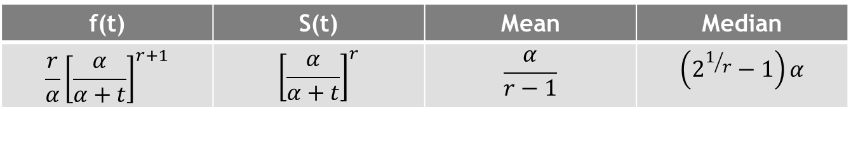
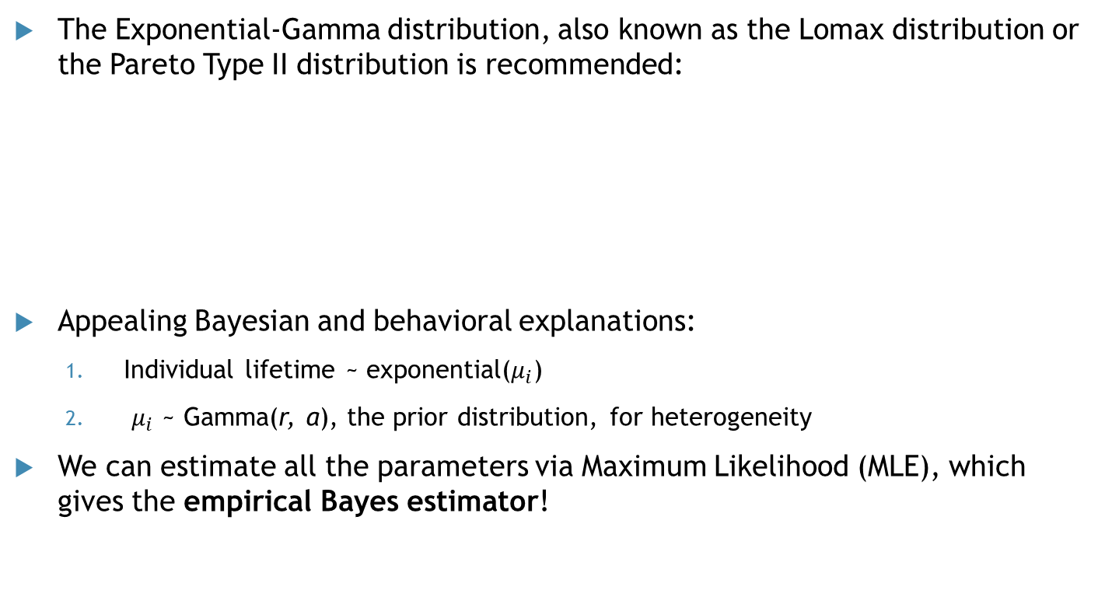
Our recommendation for f(t): Exponential Gamma
The Exponential-Gamma distribution, also known as the Lomax distribution or the Pareto Type II distribution is recommended:
Appealing Bayesian and behavioral explanations:
Individual lifetime ~ exponential($μ_{i}$)
$μ_{i}$ ~ Gamma(r, α), the prior distribution, for heterogeneity
We can estimate all the parameters via Maximum Likelihood (MLE), which gives the empirical Bayes estimator!
f(t) | S(t) | Mean | Median
$$\frac{r}{α}{\left[\frac{α}{α+t}\right]}^{r+1}$$ | $${\left[\frac{α}{α+t}\right]}^{r}$$ | $$\frac{α}{r−1}$$ | $$\left(2^{1/r}−1\right)α$$

Slide 14
Agenda
Agenda

Slide 15
Numerical example: Proposed Methodology fits the data very resulting in accurate mean (average) length of therapy
Proposed model fits the data like a “glove”
Standard probability distributions under- or over-estimate the mean
% Persistent
Mean
Calibration
Projection
+5
-4
EG mean undefined
Exponential
Proposed
Lognormal
EG (no inflation)
31% in the “inflated” group that drops off within 1st month
Remaining 69% follow the EG distribution with mean = 17.4
Proposed Model
Kaplan Meier
Lognormal
Exponential
Months (28 Days)

Slide 16
R code for replication
Eg1f_ll <- function(par,uncen,cen) {
r=par[1];
alpha=par[2]
p=par[3];
I0=which(uncen<=1);
I1=which(uncen>1);
#if uncen > 1
LL1=log(1-p)+log(r)-log(alpha)+(r+1)*log(alpha/(alpha+uncen[I1]));
#if uncen <= 1
LL2=logsumexp(rep(log(p),length(I0)),
log(1-p)+log(r)-log(alpha)+(r+1)*log(alpha/(alpha+uncen[I0])));
#if cen
LL_cen = r*log(alpha/(alpha+cen)) + log(1-p);
return (-sum(LL1)-sum(LL2)-sum(LL_cen));
}
We will open source the code in a package or in Github.

Slide 17
Remaining life: If a patient stays for t* months, how many more months will the patient remain on therapy?
% Persistent
How many more months on therapy?
t* = 5
Months (28 Days)

Slide 18
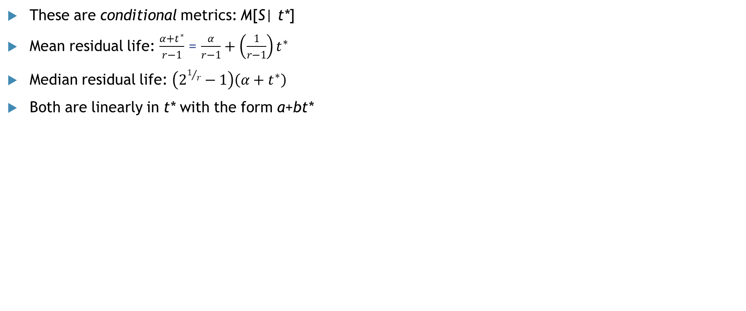
Remaining life
Mean and Median Residual Life
These are conditional metrics: M[S| t*]
Mean residual life: $\frac{α+t^{∗}}{r−1}$ = $\frac{α}{r−1}+\left(\frac{1}{r−1}\right)t^{∗}$
Median residual life: $\left(2^{1/r}−1\right)\left(α+t^{∗}\right)$
Both are linearly in t* with the form a+bt*

Slide 19
Remaining Life: Showing the linearity of both conditional residual metrics
Illustrative Example
#Remaining Life (in months)
in the 1-ω proportion, use the formulas from previous slide
At t* = 0, unconditional values are used, which account for the possibility of being both proportions
Residual Mean
Residual Median
Given #Months Stayed t*

Slide 20
Agenda
Agenda

Slide 21
Summary and Extensions
Length of therapy is an important metric in healthcare
We developed a new model to account for the often-seen 1-month drop
We showed proposed method estimated mean accurately and also showed the remaining life as conditional quantities, M[S| t*]
R codes will be shared
Extensions: Future work will explore Logistic and proportional hazard regressions can be formulated to explain the inflation and the duration process with covariates

Slide 22
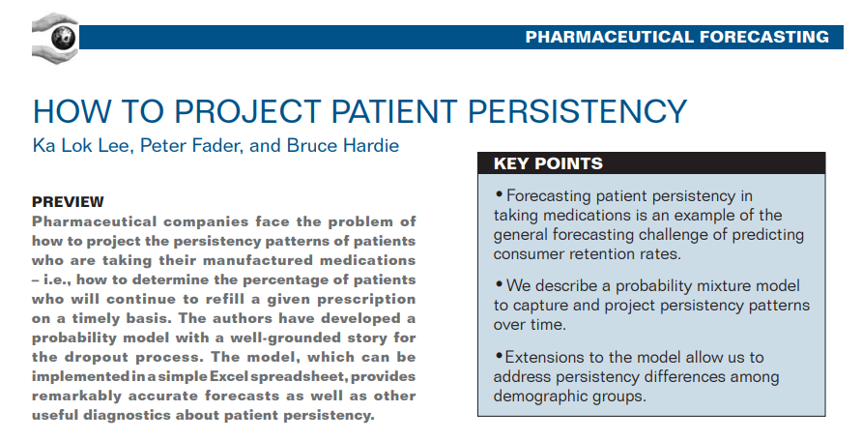
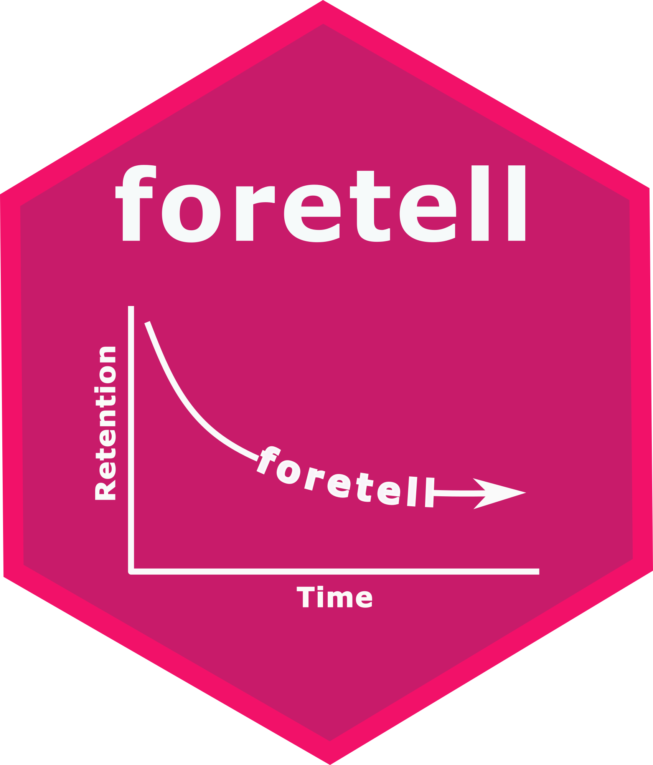

Prior Work and References
References:
Morrison, D. (1978). On linearly increasing mean residual lifetimes. Journal of Applied Probability, 15(3), 617-620.
Schmittlein, D., Morrison D. (1981). The Median Residual Lifetime: A Characterization Theorem and an Application. Operations Research 29(2):392-399.

